Slide 1
Setting Up & Learning the code

Slide 2
Outline
Setting up a development environment
What GitHub is and learning the basics
What a Code Editor is and how to begin using it
Going forward with your learning Journey
Notes:
https://github.com/join
https://code.visualstudio.com/download
https://desktop.github.com/

Slide 3

What is GitHub
A place where we can store our code and the history of the changes we have made.
It can also help with:
Code Reviews
Project Management
Integrations
Automation
Security

Slide 4



Other Repository Services
...and more

Slide 5
Demo:
Follow along with trainer
Create a repo and clone to local
Notes:
Create a readme, named the same as your username : Use template - https://rahuldkjain.github.io/gh-profile-readme-generator/
Then set Up a record of the course CPD text document. Create repo called LTU - reboot Digital Coding , Then a text document called <Name>-CPD.txt

Slide 6



Code Editors
Visual Code Studio
Atom
Sublime Text
Notes:
Introduction
A code editor is by far the most used developer tool regardless of what type of developer you are. A good code editor can help you write better code with real-time code checking, syntax highlighting, and automatic formatting.

Slide 7
Code Editor:
Demo
Notes:
Code Editors
You can think of code editors as specialised web development tools. They are highly customisable and offer many features that will make your life easier. There is nothing worse than spending 2 hours trying to figure out why your program isn’t working only to realize that you missed a closing bracket. Plugins, syntax highlighting, auto-closing of brackets and braces, and linting are just a few of the benefits of using a code editor. There are many text editors out there to choose from, but we suggest starting with VSCode.
VSCode is an excellent free code editor. It has outstanding add-on support and great Git integration.
Visual studio code commonly referred to as VS code, is one of the best code editors in the market. VS code is a product of Microsoft. Like many Microsoft brands, VS code is a cross-platform editor. Developers can use this powerful tool either on Windows, Linux, and mac. VS Code has powerful features that will fully support developers’ work. With the VS code, you are assured of fast system debugging and auto-completion.

Slide 8
Additional Setup:
Live Server Extension for VSCode
Live Demo
Notes:
An extension is a program that is meant to enhance your experience by modifying the capabilities of a software.
Just like the Google Chrome Web Browser, VSCode supports extensions and one useful one is Live Server. It has been made to save the time of developers like yourself.
This extension will save you from the hassle of refreshing the browser window repeatedly to see changes made in your code and will automatically load the most recent change in the browser window.

Slide 9
Github Desktop demo
Notes:
Using LTU - reboot Digital Coding that was cloned earlier, open the project in their code editor and demo how to fill out the CPD in the code editor how to push up the changes and how to view the changes.
Template text for CPD:
Module / Session - date
1.1. - 02/06/2020
Reflection
// Your reflection goes here
In today session I learnt that the Web Development industry is a rewarding, lucrative and creative industry to get into.
I also introduce myself to a class of strangers, this was initial a hard thing for me to undertake, but, as I heard other stories,
I began to realise that it was a good thing, and I feel that I had a break through with my confidence.
The part that I enjoyed the most was finding out what a web developer actually does, and the different roles that there are,
for instance, I did not realise that the is someone responsible for how a website looks and feels: frontend developer, and someone
responsible for the things that you don't see: Backend developer.
Additional : Show how to set Github Pages for this repo.
https://guides.github.com/features/pages/

Slide 10
Going forward with your learning Journey
Notes:
Going forward with your learning journey in conjunction with this course, here are a few tools that will help.

Slide 11







Learn Code Online For FREE
Notes:
https://learntocodewith.me/posts/code-for-free/
Q: Has anyone starting using any of these platforms, if so how are you finding them?

Slide 12
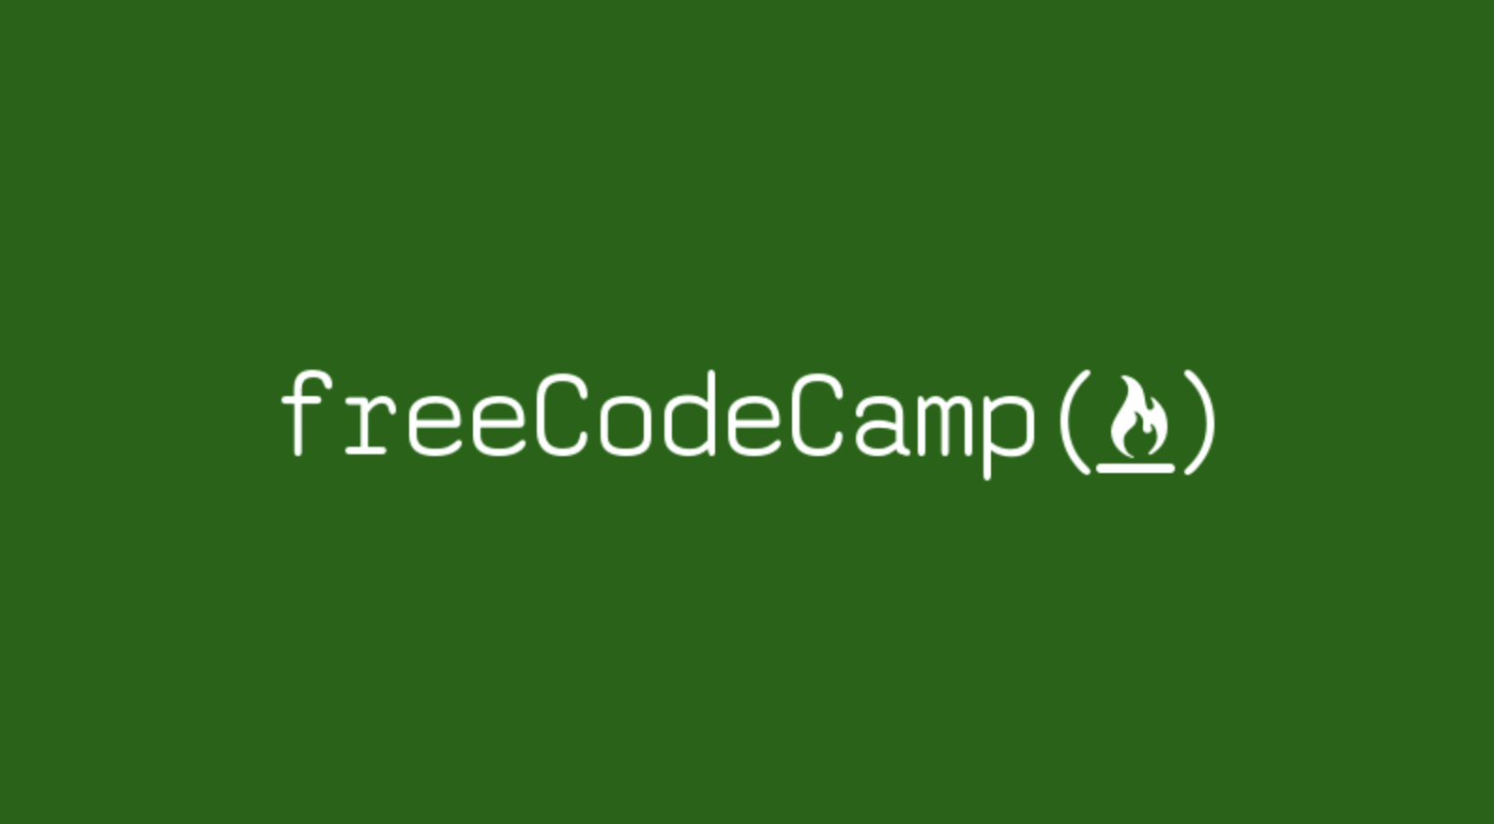
Notes:
Go to freeCodeCamp and create an account
Talk about the overall curriculum
Run through the first couple of lessons with the delegates

Slide 13
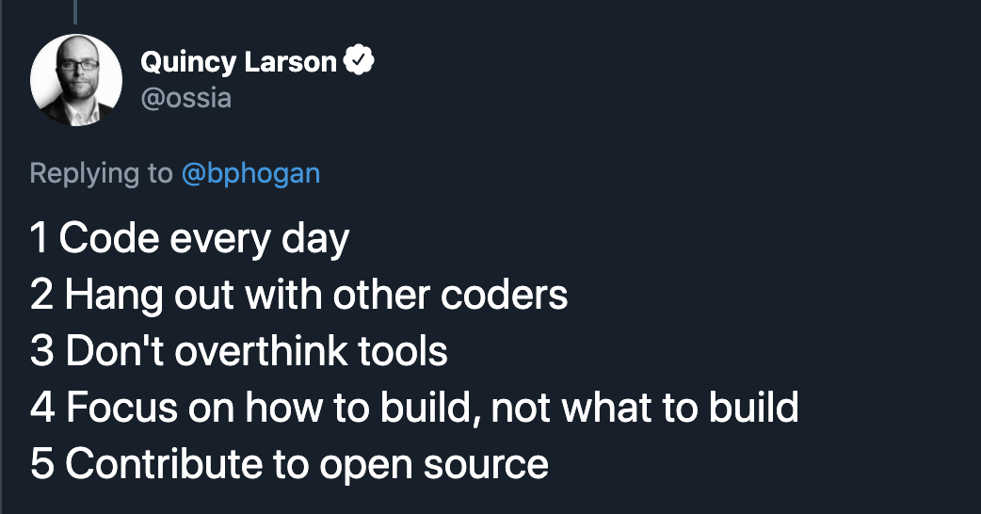
Notes:
Do 25 minutes a day and you will go far REALLY fast

Slide 14




More Tools
Notes:
These are some of the tools we’ll be using later on in the course - web dev is really exciting to learn and there is so much free stuff.
If you have gone through the slides to quickly, demo Codepen

Slide 15

Notes:
YouTube Channels, To recommend, if you have others show them too :
Academind
Ania Kubów #JavaScriptGames
codeSTACKr
Traversy Media
The Net Ninja

Slide 16

Take away Tasks
1.3.1
Write:
In our LTU - reboot Digital Coding repository <name>-CPD.txt
( text document )
Write a reflection of today’s lesson, what you learnt, and whether you found it difficult or not, use the template shown in the lesson.
Commit the change
Push to remote

